Slide 1
Weektaak 1

Slide 2
Domein en protein family (Pevsner blz 390)
Domain
Region of a protein with a particular fold + function or location in the cell
Independent structural unit, domains are evolutionary related
Protein family
Group of evolutionary related proteins that share a domain

Slide 3
PSSM (Pevsner fig 5.5)
http://www.ncbi.nlm.nih.gov/Class/Structure/pssm/pssm_viewer.cgi
PSSM van cd00581
CD search → CYSK1 (P47998)
http://www.ncbi.nlm.nih.gov/Structure/cdd/wrpsb.cgi
cd01561

Slide 4
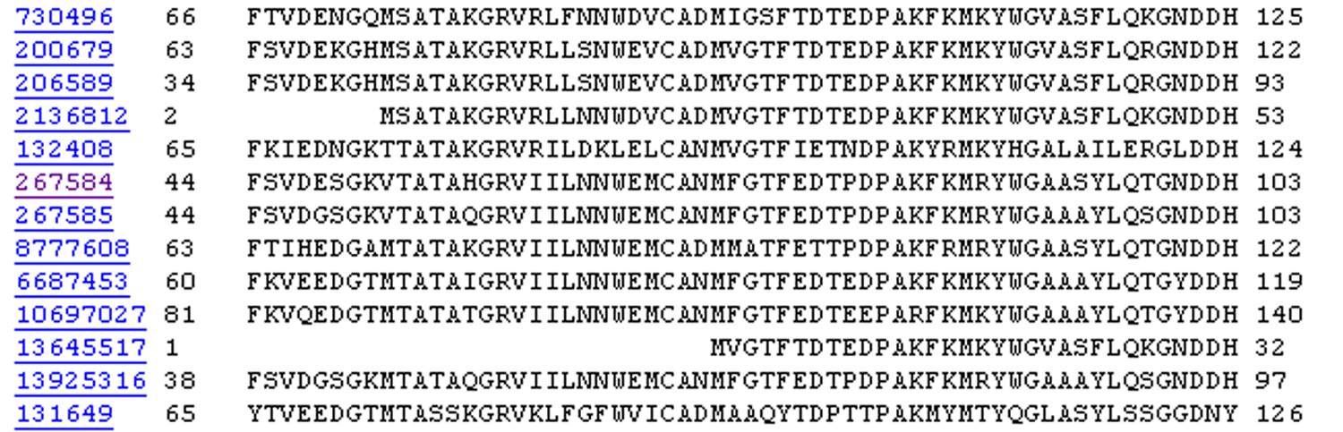
R,I,K
C
D,E,T
K,R,T
N,L,Y,G
Fig. 5.4
Page 147

Slide 5
A R N D C Q E G H I L K M F P S T W Y V
1 M -1 -2 -2 -3 -2 -1 -2 -3 -2 1 2 -2 6 0 -3 -2 -1 -2 -1 1
2 K -1 1 0 1 -4 2 4 -2 0 -3 -3 3 -2 -4 -1 0 -1 -3 -2 -3
3 W -3 -3 -4 -5 -3 -2 -3 -3 -3 -3 -2 -3 -2 1 -4 -3 -3 12 2 -3
4 V 0 -3 -3 -4 -1 -3 -3 -4 -4 3 1 -3 1 -1 -3 -2 0 -3 -1 4
5 W -3 -3 -4 -5 -3 -2 -3 -3 -3 -3 -2 -3 -2 1 -4 -3 -3 12 2 -3
6 A 5 -2 -2 -2 -1 -1 -1 0 -2 -2 -2 -1 -1 -3 -1 1 0 -3 -2 0
7 L -2 -2 -4 -4 -1 -2 -3 -4 -3 2 4 -3 2 0 -3 -3 -1 -2 -1 1
8 L -1 -3 -3 -4 -1 -3 -3 -4 -3 2 2 -3 1 3 -3 -2 -1 -2 0 3
9 L -1 -3 -4 -4 -1 -2 -3 -4 -3 2 4 -3 2 0 -3 -3 -1 -2 -1 2
10 L -2 -2 -4 -4 -1 -2 -3 -4 -3 2 4 -3 2 0 -3 -3 -1 -2 -1 1
11 A 5 -2 -2 -2 -1 -1 -1 0 -2 -2 -2 -1 -1 -3 -1 1 0 -3 -2 0
12 A 5 -2 -2 -2 -1 -1 -1 0 -2 -2 -2 -1 -1 -3 -1 1 0 -3 -2 0
13 W -2 -3 -4 -4 -2 -2 -3 -4 -3 1 4 -3 2 1 -3 -3 -2 7 0 0
14 A 3 -2 -1 -2 -1 -1 -2 4 -2 -2 -2 -1 -2 -3 -1 1 -1 -3 -3 -1
15 A 2 -1 0 -1 -2 2 0 2 -1 -3 -3 0 -2 -3 -1 3 0 -3 -2 -2
16 A 4 -2 -1 -2 -1 -1 -1 3 -2 -2 -2 -1 -1 -3 -1 1 0 -3 -2 -1
...
37 S 2 -1 0 -1 -1 0 0 0 -1 -2 -3 0 -2 -3 -1 4 1 -3 -2 -2
38 G 0 -3 -1 -2 -3 -2 -2 6 -2 -4 -4 -2 -3 -4 -2 0 -2 -3 -3 -4
39 T 0 -1 0 -1 -1 -1 -1 -2 -2 -1 -1 -1 -1 -2 -1 1 5 -3 -2 0
40 W -3 -3 -4 -5 -3 -2 -3 -3 -3 -3 -2 -3 -2 1 -4 -3 -3 12 2 -3
41 Y -2 -2 -2 -3 -3 -2 -2 -3 2 -2 -1 -2 -1 3 -3 -2 -2 2 7 -1
42 A 4 -2 -2 -2 -1 -1 -1 0 -2 -2 -2 -1 -1 -3 -1 1 0 -3 -2 0
Fig. 5.5
Page 149

Slide 6
A R N D C Q E G H I L K M F P S T W Y V
1 M -1 -2 -2 -3 -2 -1 -2 -3 -2 1 2 -2 6 0 -3 -2 -1 -2 -1 1
2 K -1 1 0 1 -4 2 4 -2 0 -3 -3 3 -2 -4 -1 0 -1 -3 -2 -3
3 W -3 -3 -4 -5 -3 -2 -3 -3 -3 -3 -2 -3 -2 1 -4 -3 -3 12 2 -3
4 V 0 -3 -3 -4 -1 -3 -3 -4 -4 3 1 -3 1 -1 -3 -2 0 -3 -1 4
5 W -3 -3 -4 -5 -3 -2 -3 -3 -3 -3 -2 -3 -2 1 -4 -3 -3 12 2 -3
6 A 5 -2 -2 -2 -1 -1 -1 0 -2 -2 -2 -1 -1 -3 -1 1 0 -3 -2 0
7 L -2 -2 -4 -4 -1 -2 -3 -4 -3 2 4 -3 2 0 -3 -3 -1 -2 -1 1
8 L -1 -3 -3 -4 -1 -3 -3 -4 -3 2 2 -3 1 3 -3 -2 -1 -2 0 3
9 L -1 -3 -4 -4 -1 -2 -3 -4 -3 2 4 -3 2 0 -3 -3 -1 -2 -1 2
10 L -2 -2 -4 -4 -1 -2 -3 -4 -3 2 4 -3 2 0 -3 -3 -1 -2 -1 1
11 A 5 -2 -2 -2 -1 -1 -1 0 -2 -2 -2 -1 -1 -3 -1 1 0 -3 -2 0
12 A 5 -2 -2 -2 -1 -1 -1 0 -2 -2 -2 -1 -1 -3 -1 1 0 -3 -2 0
13 W -2 -3 -4 -4 -2 -2 -3 -4 -3 1 4 -3 2 1 -3 -3 -2 7 0 0
14 A 3 -2 -1 -2 -1 -1 -2 4 -2 -2 -2 -1 -2 -3 -1 1 -1 -3 -3 -1
15 A 2 -1 0 -1 -2 2 0 2 -1 -3 -3 0 -2 -3 -1 3 0 -3 -2 -2
16 A 4 -2 -1 -2 -1 -1 -1 3 -2 -2 -2 -1 -1 -3 -1 1 0 -3 -2 -1
...
37 S 2 -1 0 -1 -1 0 0 0 -1 -2 -3 0 -2 -3 -1 4 1 -3 -2 -2
38 G 0 -3 -1 -2 -3 -2 -2 6 -2 -4 -4 -2 -3 -4 -2 0 -2 -3 -3 -4
39 T 0 -1 0 -1 -1 -1 -1 -2 -2 -1 -1 -1 -1 -2 -1 1 5 -3 -2 0
40 W -3 -3 -4 -5 -3 -2 -3 -3 -3 -3 -2 -3 -2 1 -4 -3 -3 12 2 -3
41 Y -2 -2 -2 -3 -3 -2 -2 -3 2 -2 -1 -2 -1 3 -3 -2 -2 2 7 -1
42 A 4 -2 -2 -2 -1 -1 -1 0 -2 -2 -2 -1 -1 -3 -1 1 0 -3 -2 0
Fig. 5.5
Page 149

Slide 7
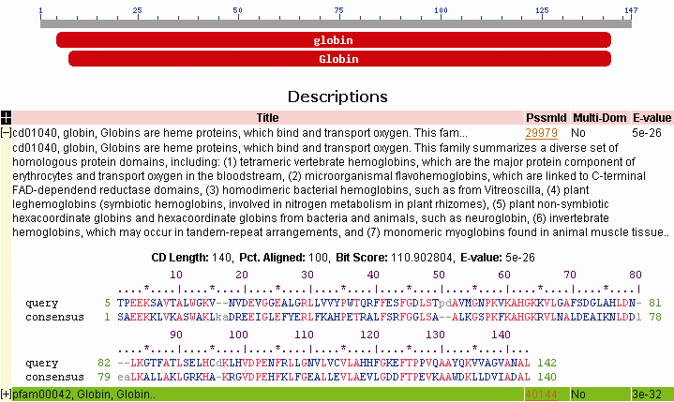
Conserved domain database (CDD) uses RPS-BLAST
Main idea: you can search a query protein against a
database of position-specific scoring matrices
Fig. 5.8
Page 153

Slide 8
HMM (Pevsner blz 155, fig 5.12)
Pfam: CYSK1 - http://pfam.xfam.org/family/PF00291
Prosite: CYSK1 - http://prosite.expasy.org/cgi-bin/prosite/nicedoc.pl?PS00901

Slide 9
Multiple sequence alignment to profile HMMs
• in the 1990’s people began to see that aligning sequences to profiles gave much more information than pairwise alignment alone.
• Hidden Markov models (HMMs) are “states”
that describe the probability of having a
particular amino acid residue at arranged
in a column of a multiple sequence alignment
• HMMs are probabilistic models
Page 155

Slide 10
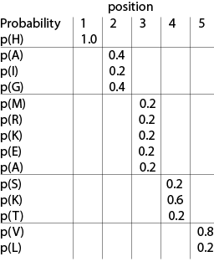
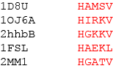
Fig. 5.11
Page 157

Slide 11
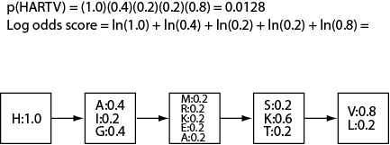
Fig. 5.11
Page 157

Slide 12
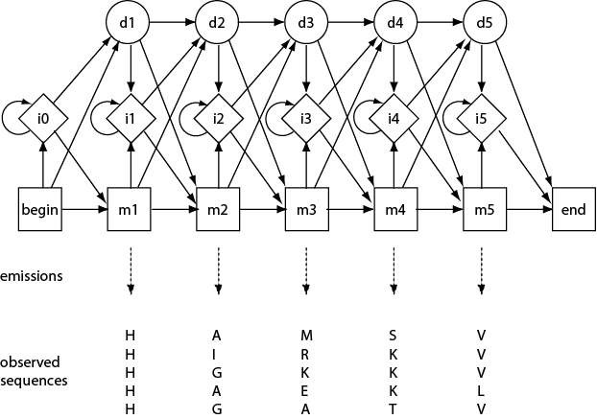
i = insert state
d = deletion state
m = main state
Fig. 5.12
Page 158

Slide 13
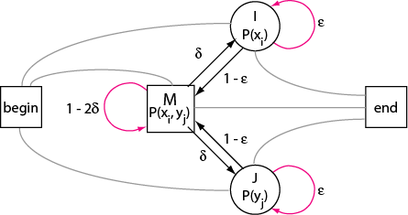
Pairwise alignment
Fig. 5.12
Page 158

Slide 14
Voorbeeld HMM
http://www.bioinfbook.org/php/?q=chapter5
HMMER - protein homology search
Fast sensitive protein homology searches using profile hidden Markov models (HMMs). Variety of different search methods for querying against both sequence and HMM target databases.
HMMbuild → make your own HMM from a multiple alignment
http://www.ebi.ac.uk/Tools/hmmer/
http://www.biology.wustl.edu/gcg/hmmerbuild.html

Slide 15
Copyright notice
Many of the images in this powerpoint presentation
are from Bioinformatics and Functional Genomics, 2nd edition
by Jonathan Pevsner (ISBN 0-471-21004-8).
Copyright © 2009 by John Wiley & Sons, Inc.
The book has a homepage at http://www.bioinfbook.org
including hyperlinks to the book chapters.

